Slide 1
Title & Team Info
Project Name: Fintech Web App – Secure Payments Platform Team Members: Gopi + Team
Owner & Version: v1.0 Scope Summary: A secure, resilient, observable microservices architecture on AWS.
Cognito JWT authentication,
Spring Boot microservices (User, Payment, Notification), RDS PostgreSQL, SQS messaging,
ALB+Ingress networking, resilience patterns, and observability with CloudWatch, Prometheus, and X-Ray.
Add content here...
Notes:
Include project name, team members, owner, version, and scope summary.

Slide 2
Scenario & Requirements
Scenario: Design a secure, highly available AWS architecture for a fintech web app:
React SPA frontend; Spring Boot microservices (Payment, User, Notification, optional Reporting);
enforce RBAC and end-to-end TLS.
Requirements Table:
Requirement | Category | Notes
User registration/login | Functional | Cognito JWT auth, RBAC enforced
Payment initiation | Functional | Payment microservice, triggers SQS event
Notifications | Functional | Notification microservice consumes SQS
Reporting | Functional | Daily aggregation of transactions
Availability ≥ 99.9% | NFR | Multi-AZ RDS, Auto Scaling EKS
Latency ≤ 250ms | NFR | ALB routing, CloudFront caching
RPO ≤ 15 min | NFR | Automated RDS backups
RTO ≤ 1 hr | NFR | Multi-AZ failover
Encryption | Security | TLS in transit, KMS at rest
Add content here...
Notes:
Add scenario description, functional requirements, NFRs, and assumptions.

Slide 3
High-Level Architecture Overview
Architecture Diagram: (Insert your VPC diagram here:
Public/Private subnets, ALB, EKS, RDS, Cognito, SQS, CloudFront)
Design Summary Table:
Component | Responsibility | HA/SLO
ALB | Routing, TLS termination | 99.99%
EKS | Microservice hosting | Auto Scaling
RDS | Transaction storage | Multi-AZ
SQS | Event queue | Durable, HA
CloudFront | CDN caching | Global edge
Add content here...
Notes:
Include design summary and rationale.

Slide 4
Tech Stack & Trade-offs
Choice | Alternative | Rationale
EKS | ECS, Lambda | JVM workloads, warm containers
RDS | DynamoDB | ACID transactions needed
ALB | API Gateway | Path-based routing, lower latency
Cognito | Custom auth | Standards-based, offloads complexity
Notes:
Justify technology choices and alternatives.

Slide 5
Component Deployment
Component | Host | Scaling | Notes
React SPA | S3 + CloudFront | CDN scaling | Cached globally
User Service | EKS | HPA | JWT validation
Payment Service | EKS | HPA | Publishes SQS events
Notification Service | EKS | HPA | Consumes SQS
RDS | Private subnet | Multi-AZ | Automated backups
Notes:
Detail frontend, backend, database, and communication components.

Slide 6
Security & Compliance
Security Approach:
Cognito JWT for authentication
RBAC enforced via Spring Security (@PreAuthorize)
IAM roles for least privilege
TLS everywhere (ALB termination + pod-to-pod mTLS optional)
Audit logs retained 90 days
IAM Roles Table:
Role | Policies | Notes
Payment Pod | sqs:SendMessage | Publishes payment events
Notification Pod | sqs:ReceiveMessage, sqs:DeleteMessage | Consumes events
User Service Pod | rds:Connect | Queries RDS
Reporting Pod | rds:ReadReplica | Aggregates transactions
App Role | cognito-idp:* | JWT validation

Slide 7
Class Diagram
Sequence Diagram (User ↔ Payment Flow) Flow: React SPA (CloudFront/S3) → User clicks Make Payment Cognito → Issues JWT (Access Token) ALB + Ingress → Routes request to User Service User Service → Validates JWT, forwards request with token Payment Service → Processes payment, persists to RDS Payment Service → Publishes event to SQS Notification Service → Consumes SQS event, sends notification Response → JSON confirmation returned to SPA 🏗️ Class Diagram (User & Payment Microservices) User Microservice UserController registerUser(UserDto) getUser(Long id) UserService saveUser(UserDto) getUserById(Long id) UserRepository save(User) findById(Long id) User Entity id: Long name: String email: String paymentCode: String | Payment Microservice PaymentController initiatePayment(PaymentDto) getPayment(String code) PaymentService savePayment(PaymentDto) getPaymentByCode(String code) PaymentRepository save(Payment) findByPaymentCode(String code) Payment Entity paymentCode: String {PK} amount: Decimal sender: String receiver: String timestamp: DateTime
Add content here...
Notes:
Sequence diagrams for user journey and internal flows.

Slide 8
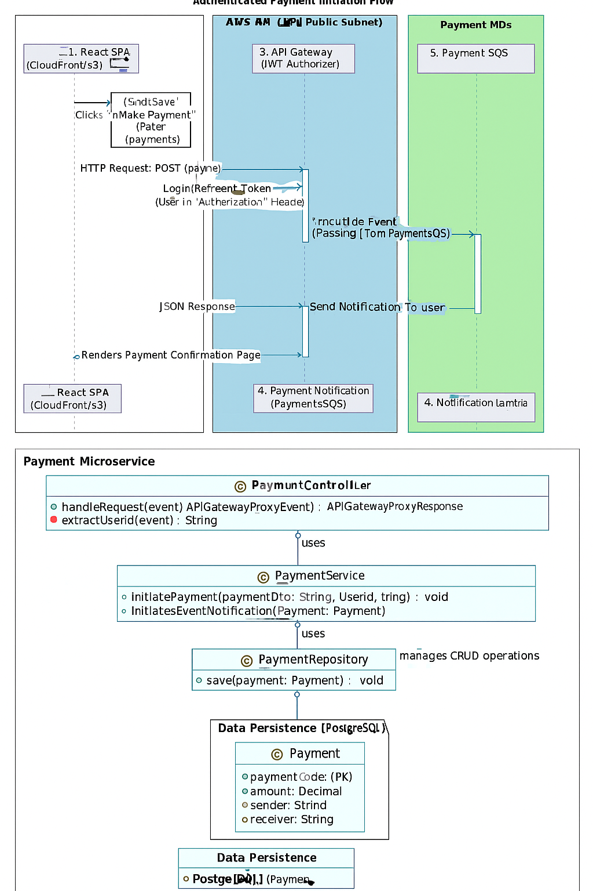
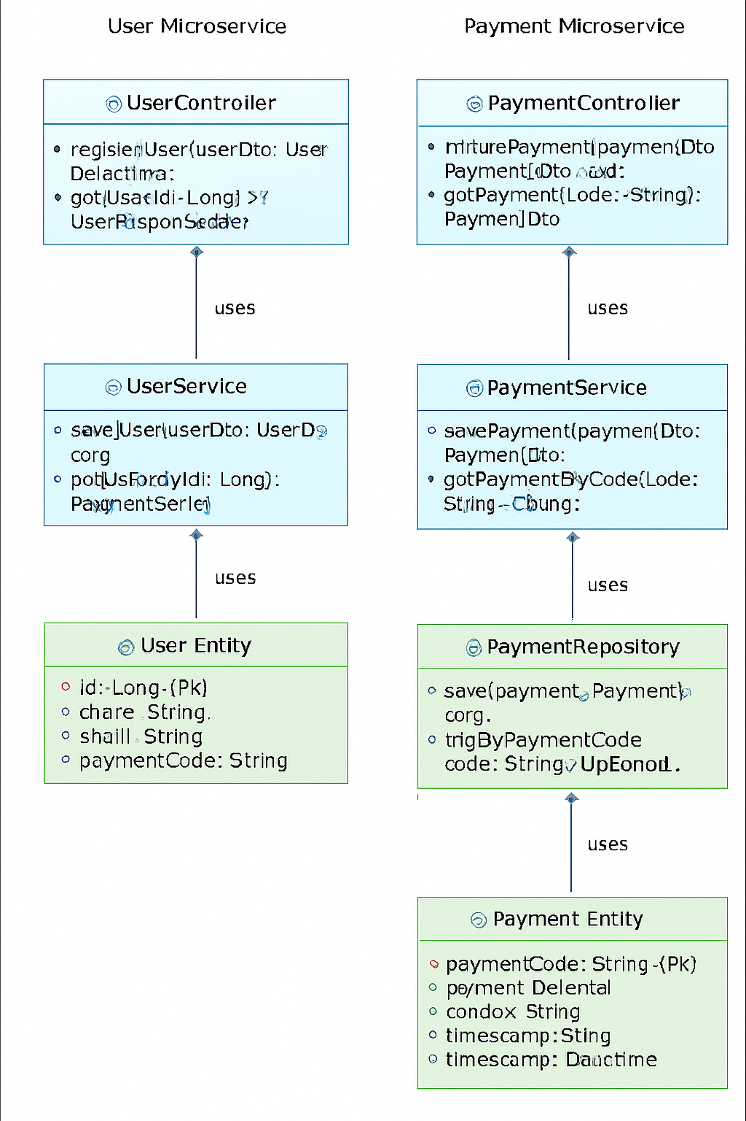
Sequence Diagram
Notes:
Class diagram for one microservice.

Slide 9
API Contracts
Endpoint | Method | Request/Response | Auth
/api/users | POST | UserDto | JWT (USER)
/api/users/{id} | GET | UserResponseDto | JWT (USER/ADMIN)
/api/payments | POST | PaymentDto | JWT (USER)
/api/payments/{code} | GET | PaymentDto | JWT (USER/ADMIN)
Add content here...
Notes:
API contracts

Slide 10
Scalability & Resilience
Scalability Diagram:
ALB → EKS pods (HPA scaling) → RDS Multi-AZ → SQS scaling consumers.
Resilience Table:
Service | Metric | Action
EKS | CPU/Memory | HPA scaling
RDS | Replica lag | Add read replicas
SQS | Queue depth | Scale consumers
ALB | Latency | Auto scaling backend
Add content here...
Notes:
Explain auto scaling, high availability, caching, and disaster recovery.

Slide 11
Monitoring & Observability
Monitoring Diagram:
CloudWatch metrics + Prometheus scraping → Grafana dashboards → X-Ray traces.
Logging Table:
Component | Metric | Threshold
EKS Pods | CPU | >80%
RDS | Connections | >500
SQS | Queue depth | >1000
ALB | Latency | >250ms
CloudFront | Cache hit ratio | <80%
Add content here...
Notes:
Include metrics, alarms, logs, and tracing.

Slide 12
Testing Strategy
Test Type | Scope | Tools
Unit | Microservice classes | JUnit
Integration | Service-to-service | Postman
Load | TPS simulation | JMeter
Security | IAM, JWT | OWASP ZAP
Add content here...
Notes:
Describe unit/integration tests, load tests, security tests, and acceptance criteria.

Slide 13
Cost & Optimization
Service | Driver | Notes
EKS | Compute | Use Savings Plans
RDS | Storage | Right-size, Multi-AZ
S3+CloudFront | Bandwidth | Cache, lifecycle policies
SQS | Requests | DLQ for retries
Add content here...
Notes:
List cost drivers and optimization strategies.

Slide 14
Risks & Mitigations
Risk | Likelihood | Impact | Mitigation
AZ failure | Medium | High | Multi-AZ
Token expiry | High | Medium | Refresh flow
Cost overruns | Medium | High | Budgets, alerts
Queue overload | Medium | Medium | DLQ, scaling
Notes:
Identify top risks, mitigation strategies, and residual risks.

Slide 15
References & Links
AWS Well-Architected Framework
Cognito Developer Guide
Spring Security Docs
Resilience4j Docs
Prometheus + Grafana setup
AWS SQS Developer Guide
Notes:
Provide document links, version history, and related artifacts.

Slide 16
Q & A
Present prepared responses to team questions (e.g., why EKS vs Lambda, why RDS vs DynamoDB).
Open floor for audience questions.
Notes:
Provide document links, version history, and related artifacts.

